Slide 1
Green hydrogen from hydropower A non-cooperative modeling approach assessing the profitability gap and future business cases
NTNU Energy Systems Seminar
Connecting Energy Transition Researchers Across Disciplines
Sebastian Zwickl-Bernhard
26.08.2022, Trondheim, Norway
10.1016/j.esr.2022.100912
This work has received funding from the European Union’s Horizon 2020 research and innovation programme undere grant No. 835896
Code available at GitHub
This presentation is licensed under a Creative Commons Attribution 4.0 International License
Video available at YouTube

Slide 2
Team at TU Vienna
Professor
University Assistant
University Assistant
Project Assistant
Student Assistant
Hans Auer
Theresia Perger
Antonia Golab
Sebastian Zwickl-Bernhard
Marcus Otti

Slide 3
Todays‘ agenda
Motivation and background
Core objective and main research question
Methodology
Results
Conclusions and outlook

Slide 4
Introduction and motivation
Hydrogen can play a pivotal role in the sustainable energy system transformation
Offers the opportunity to decarbonize the provision of numerous energy services and sectors
Adds additional integrated flexibility options, which can be used cross-sectoral and system-overarching
Hydrogen deployment is also essential in most of the decarbonization pathways and sustainable economy/society storylines
The crucial questions remain
(i) How is hydrogen produced in practice (primary fuels)?
(ii) How does the corresponding profitability look like?
(iii) How may various business cases succeed, taking into account the individual objectives of the agents involved?

Slide 5
Core objective / research question
The core objective is to investigate a possible future business case for green hydrogen production from hydropower.
In particular, the main research question is to find the trade-offs for a run-of-river hydropower plant owner between trading of electricity (e.g., forward/future electricity contracts or at the day-ahead spot market) and, alternatively, production of green hydrogen.
The optimal exploitation and allocation of hydropower resources play a key role in the analysis.
Equally important is the impact of different CO2 prices on the profitability of electricity trading and green hydrogen production.

Slide 6
Methodology applied
Development of a non-cooperative optimization model (Stackelberg game).
Thereby, the bi-level optimization framework is implemented with a single leader (H2 producer) and follower (H2 consumer).
Both agents are profit oriented. Their objectives are maximizing revenues and minimizing total costs, respectively.
H2 producer is the price setter and H2 consumer is the price taker for green hydrogen.

Slide 7
Formulation of the H2 consumer (follower)
(1) Objective function
(2) Decision variables
(3) Parameters
(4) Constraint - load
(5) Constraint - emissions

Slide 8
Formulation of the H2 producer (leader)
(1) Objective function
(2) Decision variables
(3) Parameters
(4) Constraint - generation
(5) Constraint - constant

Slide 9
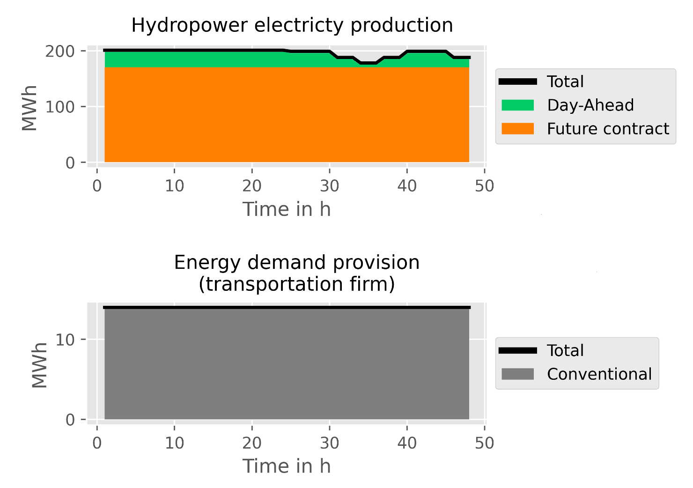
Results 1/5: Resource allocation
Hydropower plant resource allocation and energy demand provision of the transportation firm

Slide 10
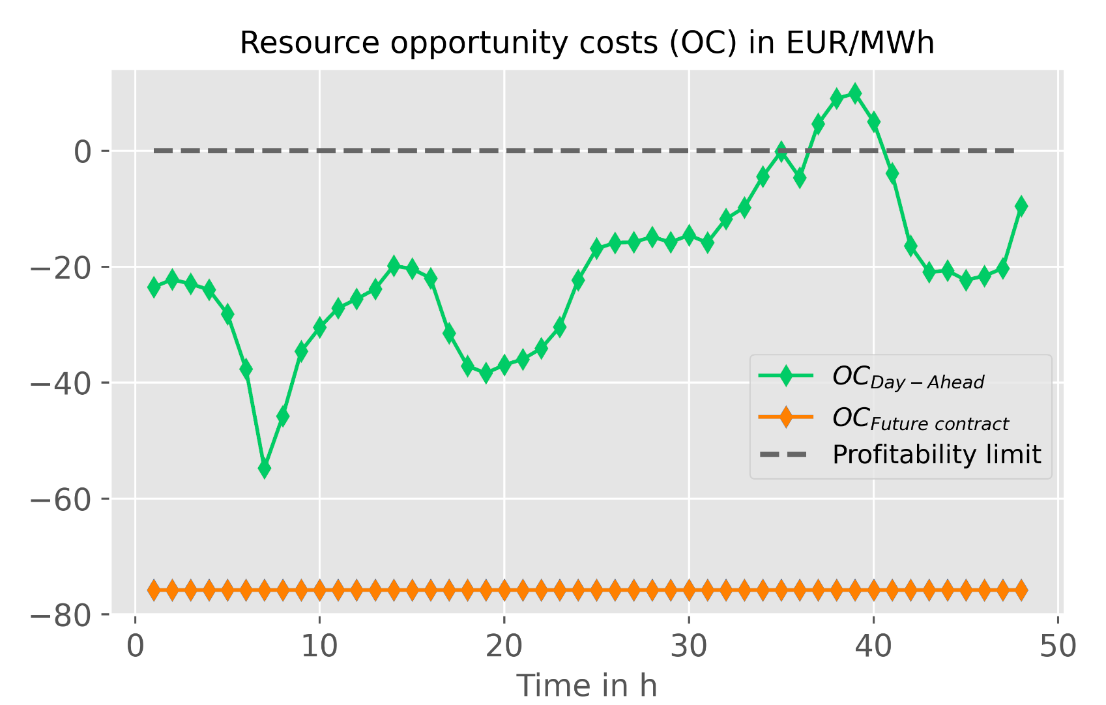
Results 2/5: Profitability gap

Slide 11
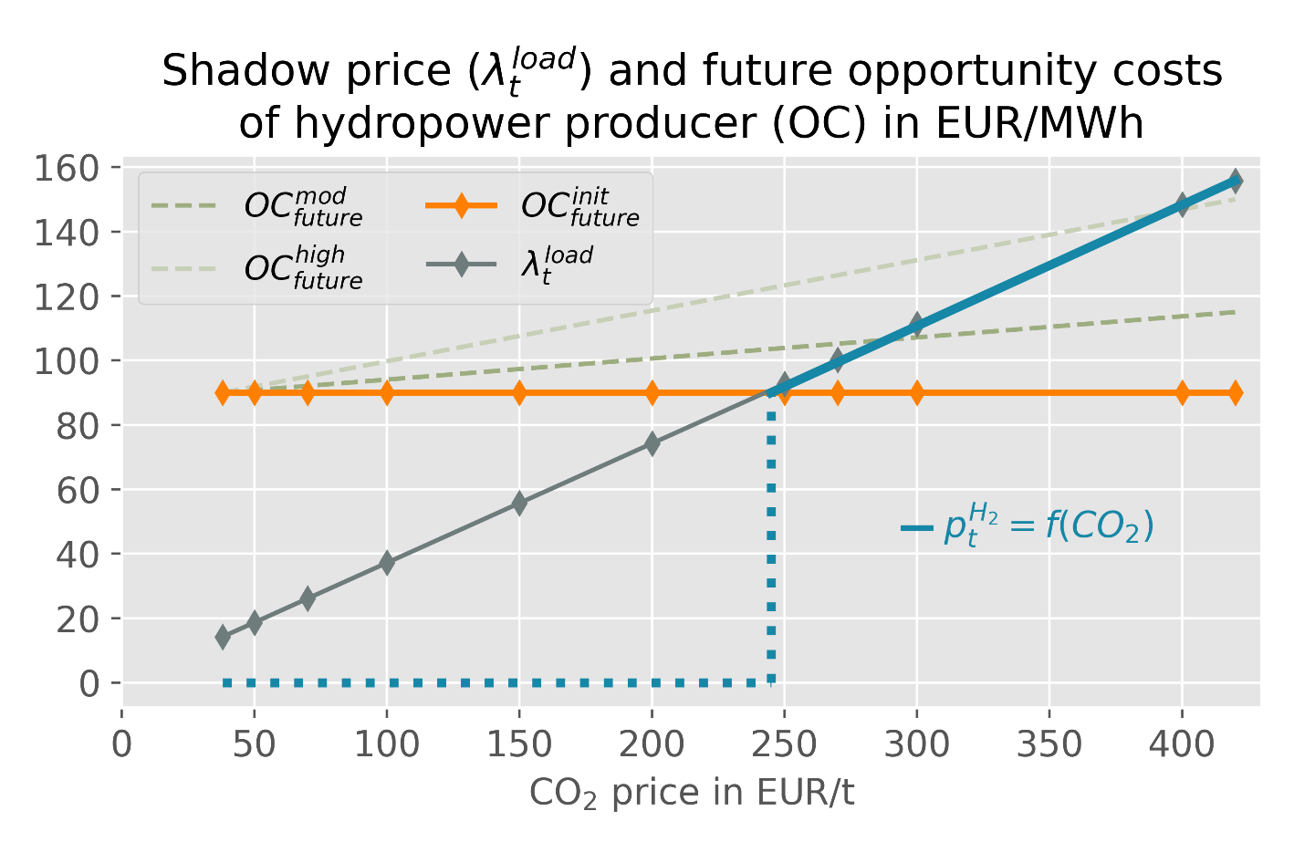
Results 3/5: Hydrogen price
Hydrogen price set depending on shadow price and opportunity costs

Slide 12
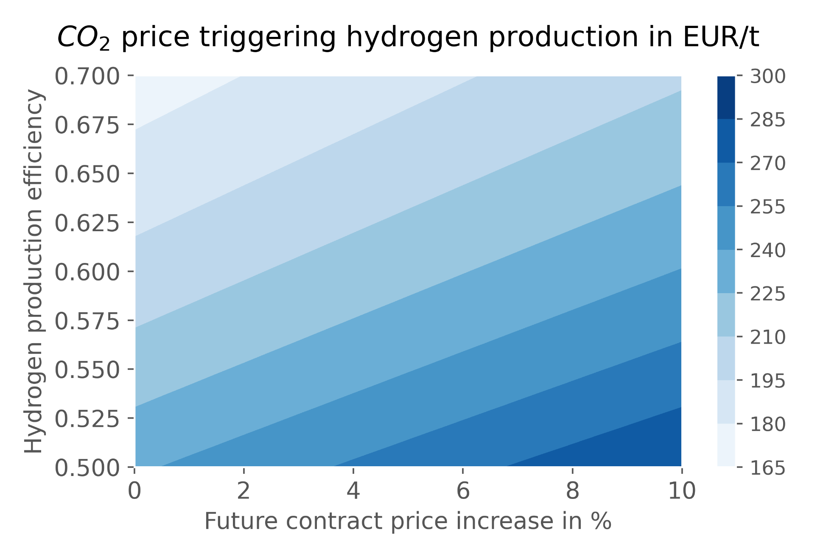
Results 4/5: Sensitivity analysis
Electricity price and hydrogen production efficiency

Slide 13
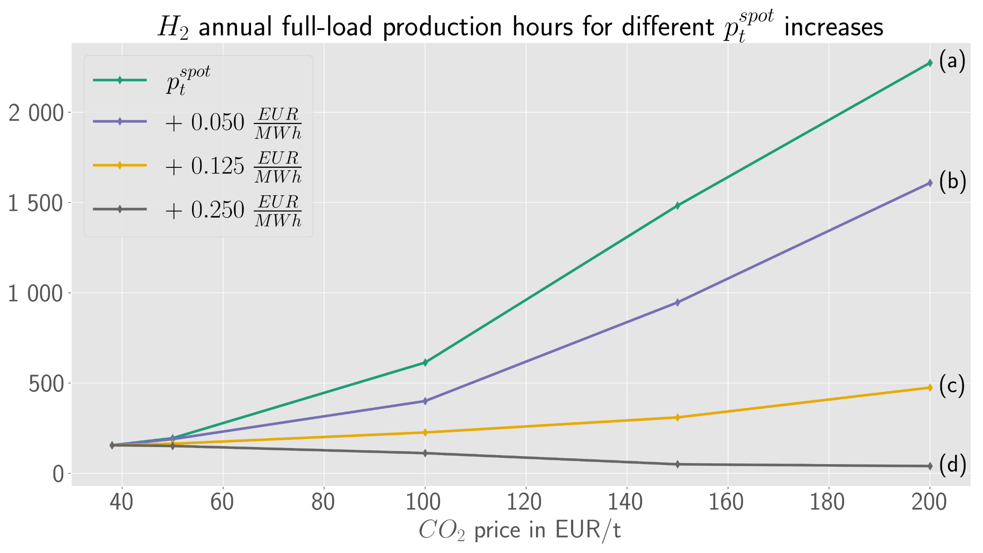
Results 5/5: Full-load production hours

Slide 14
Conclusions and outlook
Current market environment and price setup do not allow for profitable green hydrogen production as yet.
An Increasing CO2 price, as the key determining parameter, leads to improved competitiveness along with the emerging market penetration of hydrogen.
In the numerical example examined, a CO2 price above 245 EUR/t triggers a profitable business case.
Hydrogen deployment may also significantly depend on the price development on the wholesale electricity markets with underlying driving factors in both directions, supporting and limiting green hydrogen deployment.
Future work may address, among others, the investigation of the impact on green hydrogen production from hydropower in a predominantly renewable energy-based power plant portfolio.

Slide 15
Sebastian Zwickl-Bernhard (zwickl@eeg.tuwien.ac.at)
Collaborate on GitHub
Connect on LinkedIn
ORCID
Google Scholar

